Slide 1
Topology optimization of a Dam in 3D
By
Sumanthreddy

Slide 2
Contents:
Topology Optimization
Problem Statement
Design
Methods
Post Processing
Comparison
Outputs
Challenges and Further works

Slide 3
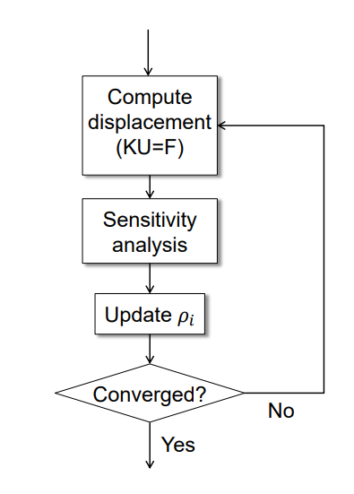
Topology Optimization:

Slide 4
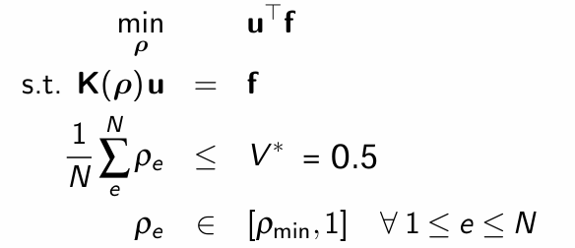
Problem Statement:

Slide 5
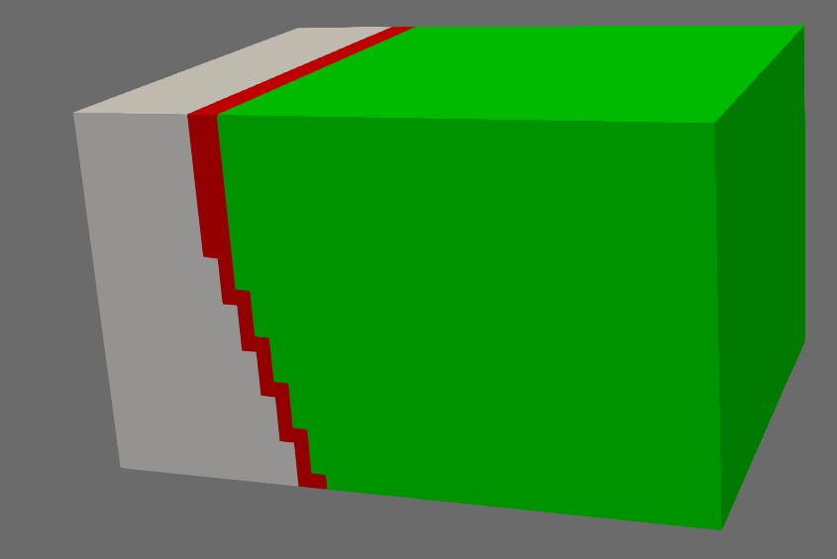
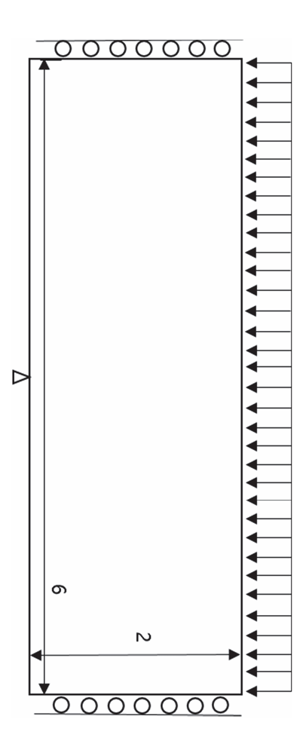
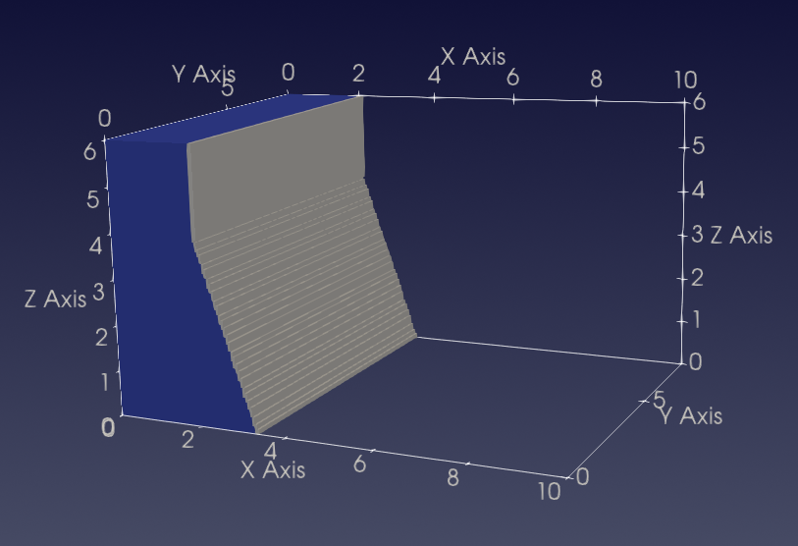
Design:
F

Slide 6
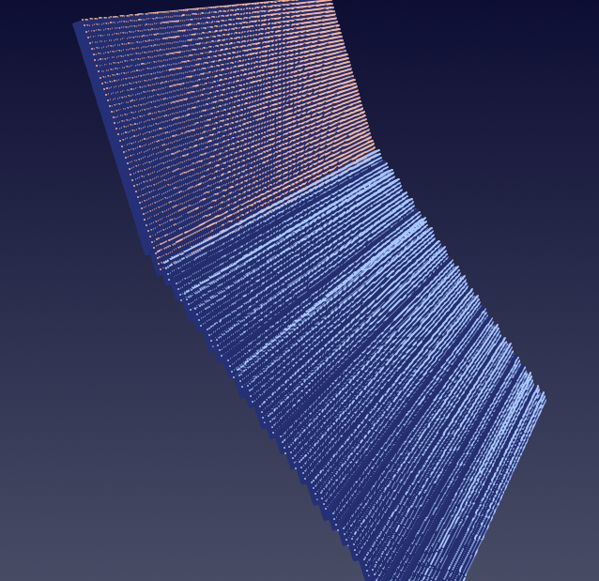
Nodes:
Force is acting along x axis in the negative direction
Force: 0.1*Area

Slide 7

Methods applied:
Optimizer - SNOPT
Multiple load case
Heaviside filter with continuation

Slide 8
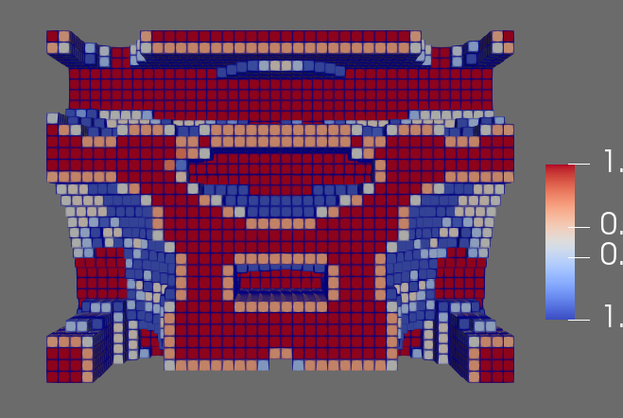
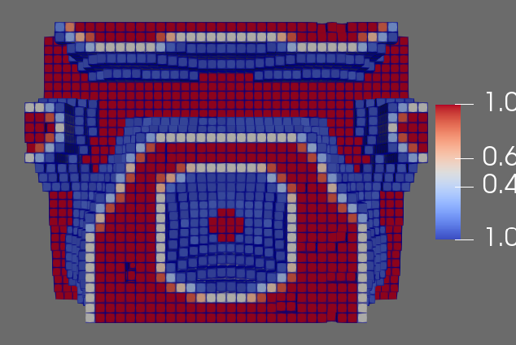
SIMP vs Multiload

Slide 9
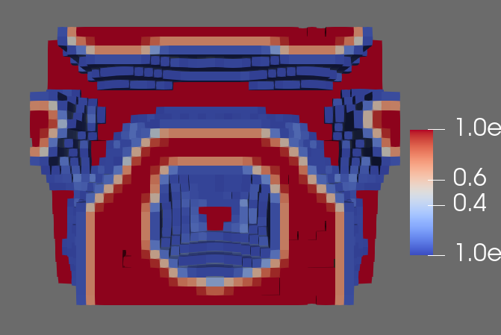
Multiload vs Heaviside

Slide 10
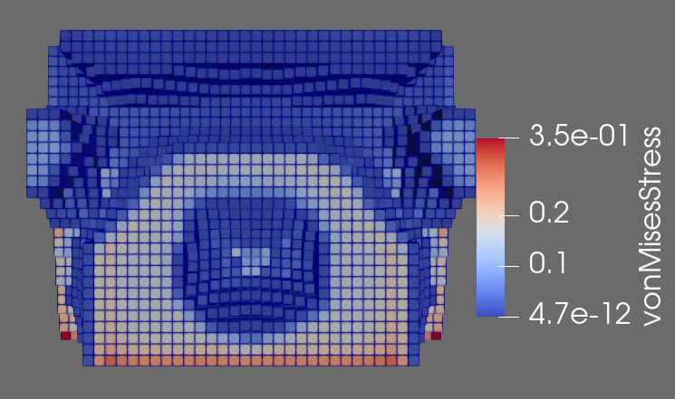
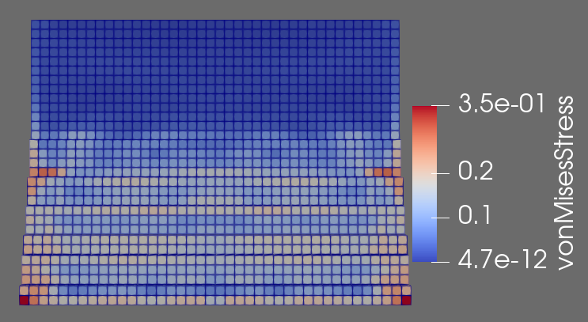
Von-Mises Stress:

Slide 11
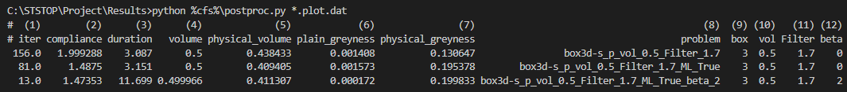
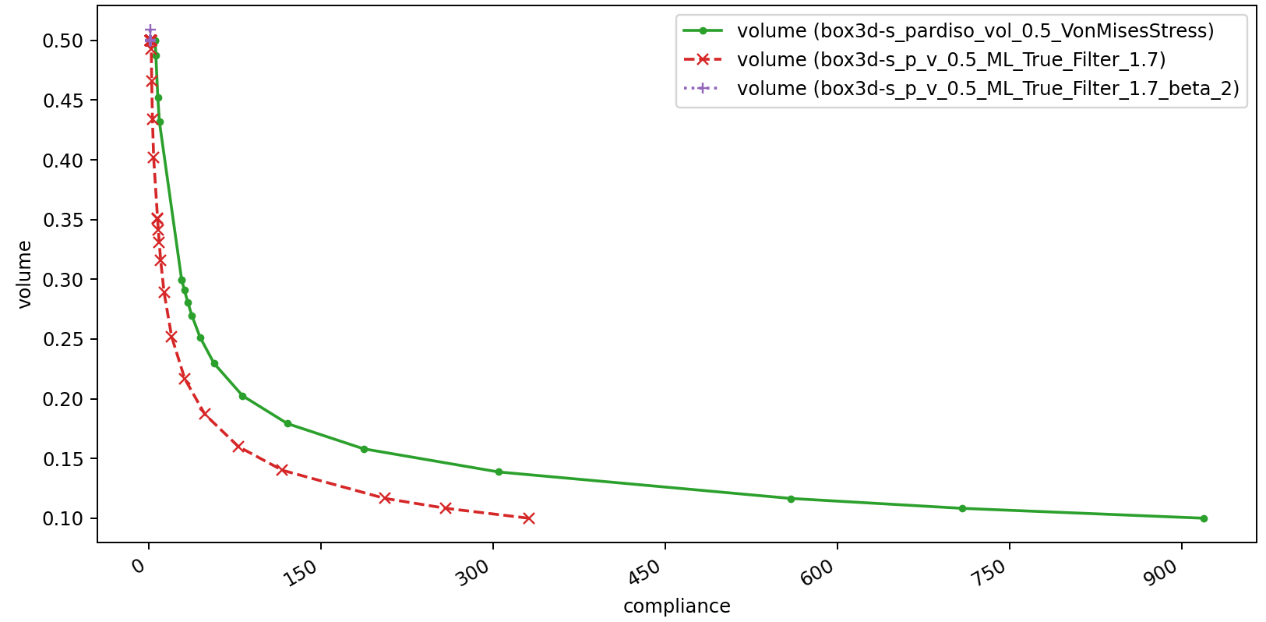
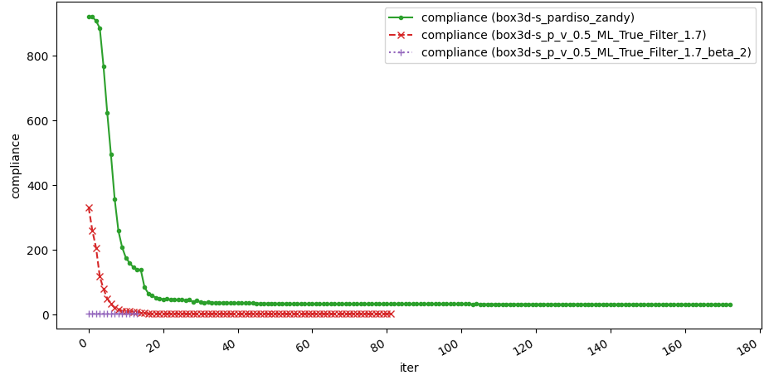
Results:

Slide 12
Challenges faced:
“Not enough memory. Try to switch to out-of-core mode if using MKL” i.e, Memory issue
Applying pressure instead of Force
Appending nodes to nodelist

Slide 13
Further Works:
Instead of assuming just one design start with sizing, then shape and then do Topology Optimization
Implementation of stresses optimization and robust optimization(unexpected loads)
Change parameters like initial vol, volume constraint and filter
Performing the Topology Optimization at more sectors at the same time because each sector has different stresses
Notes:
optimizer tunes strictly for the defined load case the design can perform arbitrary poor for an unexpected load →request for robustness against loading Performing Topology Optimization at multiple sectors simultaneously refers to optimizing the design of a structure in different regions or sections concurrently. This approach is often adopted when different sectors of a structure experience distinct loading conditions or stresses. Instead of optimizing the entire structure as a single entity, the optimization is performed separately for each sector, taking into account the unique stress patterns and requirements in those specific regions.

Slide 14

THANK YOU

